Slide 1
Murach’s C# (8th Edition)
Chapter 6
How to code methods and event handlers

Slide 2
Objectives
Given the specifications for a method, write the method.
Give the documentation for a method including its signature, use the method.
Give a portion of code that can be converted to a method call and a method, use refactoring to do the conversion.

Slide 3
Objectives (continued)
Knowledge
Describe the signature of a method.
Describe an expression-bodied method.
Explain the difference between passing an argument by value and by reference.
Describe the use of optional arguments.
Describe the advantages of passing arguments by name.
Describe the use of a tuple as the return type of a method.
In general terms, describe: How event wiring works in C# What you need to do to delete an event How you can use one event handler to handle two or

Slide 4
A method with no parameters and no return type
private void DisableButtons()
{
btnCalculate.Enabled = false;
btnExit.Enabled = false;
}

Slide 5
A method with one parameter that returns a decimal value
private decimal GetDiscountPercent(decimal subtotal)
{
decimal discountPercent = 0m;
if (subtotal >= 500)
discountPercent = .2m;
else
discountPercent = .1m;
return discountPercent;
}

Slide 6
A method with three parameters that returns a decimal value
private decimal CalculateFutureValue(
decimal monthlyInvestment,
decimal monthlyInterestRate, int months)
{
decimal futureValue = 0m;
for (int i = 0; i < months; i++)
{
futureValue = (futureValue + monthlyInvestment)
* (1 + monthlyInterestRate);
}
return futureValue;
}

Slide 7
Statements that call methods
A call to a method that has no parameters
this.DisableButtons();
A statement that passes one argument
decimal discountPercent = this.GetDiscountPercent(subtotal);
A statement that passes three arguments
decimal futureValue = CalculateFutureValue(
monthlyInvestment, monthlyInterestRate, months);

Slide 8
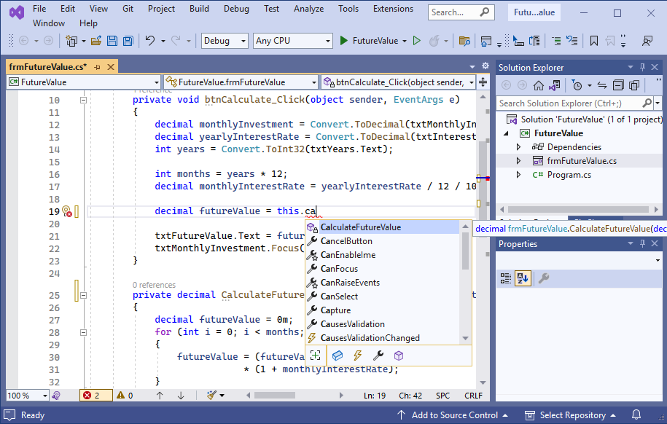
The IntelliSense feature for calling a method

Slide 9
The CalculateFutureValue() method with two optional parameters
private decimal CalculateFutureValue(
decimal monthlyInvestment,
decimal monthlyInterestRate = 0.05m, int months = 12)
{
decimal futureValue = 0m;
for (int i = 0; i < months; i++)
{
futureValue = (futureValue + monthlyInvestment) *
(1 + monthlyInterestRate);
}
return futureValue;
}

Slide 10
A statement that passes arguments for all three parameters to the function
decimal futureValue = CalculateFutureValue(
monthlyInvestment, monthlyInterestRate, months);

Slide 11
A statement that omits the argument for the third parameter
decimal futureValue = CalculateFutureValue(
monthlyInvestment, monthlyInterestRate);

Slide 12
Two statements that pass the arguments for two parameters by name
decimal futureValue = CalculateFutureValue(
monthlyInvestment:monthlyInvestment, months:months);
decimal futureValue = CalculateFutureValue(
months:months, monthlyInvestment:monthlyInvestment);

Slide 13
A statement that passes one argument by position and one by name
decimal futureValue = CalculateFutureValue(
monthlyInvestment, months:months);

Slide 14
A method that executes a single statement
private void DisplayErrorMessage( string message, string caption)
{
MessageBox.Show(message, caption);
}
The same method with an expression body
private void DisplayErrorMessage(
string message, string caption)
=> MessageBox.Show(message, caption);

Slide 15
A method that returns the value of an expression
private decimal GetDiscountPercent(string customerType)
{
return customerType switch
{
"R" => .1m,
"C" => .2m,
"T" => .4m,
_ => .0m
};
}
The same method with an expression body
private decimal GetDiscountPercent(string customerType) =>
customerType switch
{
"R" => .1m,
"C" => .2m,
"T" => .4m,
_ => .0m
};

Slide 16
The btnCalculate_Click() method with selected statements
private void btnCalculate_Click(object sender, EventArgs e)
{
decimal monthlyInvestment =
Convert.ToDecimal(txtMonthlyInvestment.Text);
decimal yearlyInterestRate =
Convert.ToDecimal(txtInterestRate.Text);
int years = Convert.ToInt32(txtYears.Text);
int months = years * 12;
decimal monthlyInterestRate = yearlyInterestRate / 12 / 100;
decimal futureValue = 0m;
for (int i = 0; i < months; i++)
{
futureValue = (futureValue + monthlyInvestment)
* (1 + monthlyInterestRate);
}
txtFutureValue.Text = futureValue.ToString("c");
txtMonthlyInvestment.Focus();
}

Slide 17
The method call that replaces the selected code
decimal futureValue = CalculateFutureValue( monthlyInvestment, months, monthlyInterestRate);

Slide 18
The method that’s added to the class
private static decimal CalculateFutureValue(
decimal monthlyInvestment, int months, decimal monthlyInterestRate)
{
decimal futureValue = 0m;
for (int i = 0; i < months; i++)
{
futureValue = (futureValue + monthlyInvestment)
* (1 + monthlyInterestRate);
}
return futureValue;
}

Slide 19
A CalculateFutureValue() method that uses the ref keyword
private void CalculateFutureValue(
decimal monthlyInvestment,
decimal monthlyInterestRate, int months,
ref decimal futureValue)
{
for (int i = 0; i < months; i++)
{
futureValue = (futureValue + monthlyInvestment)
* (1 + monthlyInterestRate);
}
}

Slide 20
Three statements that work with the CalculateFutureValue() method
decimal futureValue = 0m;
CalculateFutureValue(monthlyInvestment,
monthlyInterestRate, months, ref futureValue);
txtFutureValue.Text = futureValue.ToString("c");

Slide 21
A CalculateFutureValue() method that uses the out keyword
private void CalculateFutureValue(
decimal monthlyInvestment,
decimal monthlyInterestRate, int months,
out decimal futureValue)
{
for (int i = 0; i < months; i++)
{
futureValue = (futureValue + monthlyInvestment)
* (1 + monthlyInterestRate);
}
}

Slide 22
Two statements that work with the CalculateFutureValue() method
decimal futureValue;
CalculateFutureValue(monthlyInvestment,
monthlyInterestRate, months, out futureValue);
Another way to work with this method (C# 7.0 and later)
CalculateFutureValue(monthlyInvestment,
monthlyInterestRate, months, out decimal futureValue);

Slide 23
A CalculateFutureValue() method that uses the in keyword (C# 7.2 and later)
private void CalculateFutureValue(
in decimal monthlyInvestment,
in decimal monthlyInterestRate,
in int months, out decimal futureValue)
{
for (int i = 0; i < months; i++)
{
futureValue = (futureValue + monthlyInvestment)
* (1 + monthlyInterestRate);
}
}
A statement that calls this method
CalculateFutureValue(monthlyInvestment,
monthlyInterestRate, months, out decimal futureValue);

Slide 24
How to create and work with an unnamed tuple
How to create an unnamed tuple with two members
var person = ("Anne Boehm", 62);
How to refer to the members of the tuple
person.Item1
person.Item2

Slide 25
How to create and work with a named tuple
How to create a tuple with two members
var person = (Name: "Anne Boehm", Age: 62);
How to create the tuple and declare its member types
(string Name, int Age) person = ("Anne Boehm", 62);
How to refer to the members of the tuple
person.Name
person.Age

Slide 26
How to create a tuple using variable names (C# 7.1 and later)
How to create a tuple with two members
string name = "Anne Boehm";
int age = 62;
var person = (name, age);
How to refer to the members of the tuple
person.name
person.age

Slide 27
A CalculateFutureValue() method that returns a tuple
private (decimal FutureValue, decimal TotalInterest)
CalculateFutureValue(decimal monthlyInvestment,
decimal monthlyInterestRate, int months)
{
decimal futureValue = 0m;
decimal totalInterest = 0m;
decimal monthlyInterest = 0m;
for (int i = 0; i < months; i++)
{
monthlyInterest =
(futureValue + monthlyInvestment)
* monthlyInterestRate;
totalInterest += monthlyInterest;
futureValue += monthlyInvestment
+ monthlyInterest;
}
return (futureValue, totalInterest);
}

Slide 28
A statement that calls the CalculateFutureValue() method and deconstructs the tuple
(decimal FutureValue, decimal TotalInterest) =
CalculateFutureValue(monthlyInvestment, monthlyInterestRate, months);
Statements that refer to the members of the tuple
txtFutureValue.Text = FutureValue.ToString("c");
txtTotalInterest.Text = TotalInterest.ToString("c");

Slide 29
A statement that calls the CalculateFutureValue() method and assigns the tuple to a variable
var calculations = CalculateFutureValue(
monthlyInvestment, monthlyInterestRate, months);
Statements that refer to the members of the tuple
txtFutureValue.Text = calculations.FutureValue.ToString("c");
txtTotalInterest.Text = calculations.TotalInterest.ToString("c");

Slide 30
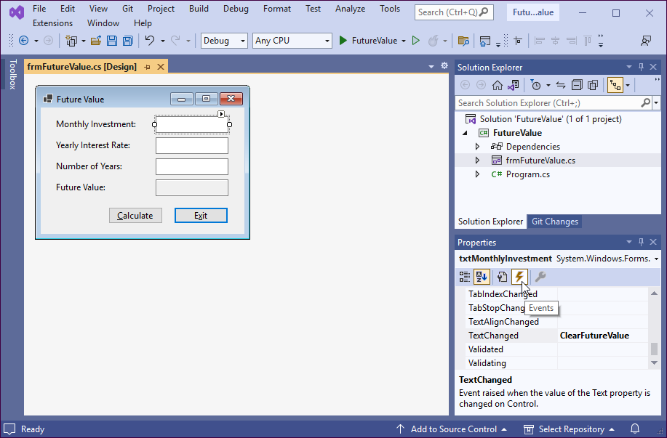
The Events list for a text box control

Slide 31
The default event handler for a text box
The method declaration for the event handler
private void txtMonthlyInvestment_TextChanged(
object sender, EventArgs e)
{
}
The generated statement that wires the event to the event handler
txtMonthlyInvestment.TextChanged += txtMonthlyInvestment_TextChanged;

Slide 32
A custom event handler for a text box
The method declaration for the event handler
private void ClearFutureValue(
object sender, EventArgs e)
{
}
The generated statement that wires the event to the event handler
txtMonthlyInvestment.TextChanged += ClearFutureValue;

Slide 33
A statement that explicitly creates the delegate object
this.txtMonthlyInvestment.TextChanged +=
new System.EventHandler(this.ClearFutureValue);

Slide 34
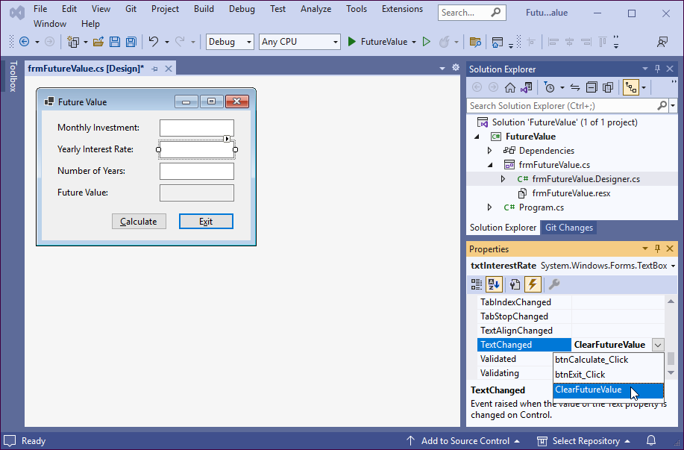
How to select an existing event handler for an event

Slide 35
The code for the methods of the Future Value app
private void btnCalculate_Click(
object sender, EventArgs e)
{
decimal monthlyInvestment =
Convert.ToDecimal(txtMonthlyInvestment.Text);
decimal yearlyInterestRate =
Convert.ToDecimal(txtInterestRate.Text);
int years = Convert.ToInt32(txtYears.Text);
int months = years * 12;
decimal monthlyInterestRate =
yearlyInterestRate / 12 / 100;
decimal futureValue = CalculateFutureValue(
monthlyInvestment, monthlyInterestRate, months);
txtFutureValue.Text = futureValue.ToString("c");
txtMonthlyInvestment.Focus();
}

Slide 36
The code for the methods (continued)
private decimal CalculateFutureValue(
decimal monthlyInvestment, decimalmonthlyInterestRate,
int months)
{
decimal futureValue = 0m;
for (int i = 0; i < months; i++)
{
futureValue = (futureValue + monthlyInvestment)
* (1 + monthlyInterestRate);
}
return futureValue;
}
private void btnExit_Click(object sender, EventArgs e)
{
this.Close();
}
private void ClearFutureValue(object sender, EventArgs e)
{
txtFutureValue.Text = "";
}

